Slide 1
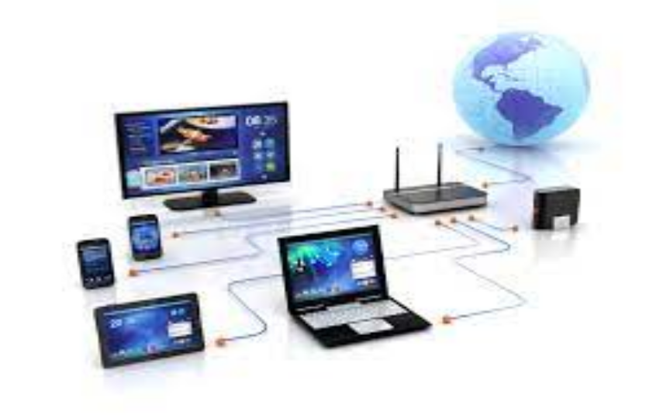
Unit 2.1 - Computer Networks
Prepared by: Koh Kian Hua

Slide 2
Objectives (Part 2)
After completing this unit, students should be able to:
Understand the use of the bus, star, mesh and hybrid topologies in a given situation and how packets are transmitted in each topology.
Understand the use of cloud computing (private and public clouds) and the benefits and drawbacks of cloud computing.
Understand the differences between wired and wireless networks and be able to identify the characteristics of different data transmission devices (copper, cable, fibre optic, radio waves and microwaves).

Slide 3
Computer Networks
Networks Toplologies
Computers can be connected based on serveral topolgies:
bus networks
star networks
ring networks
mesh networks
hybrid networks.

Slide 4
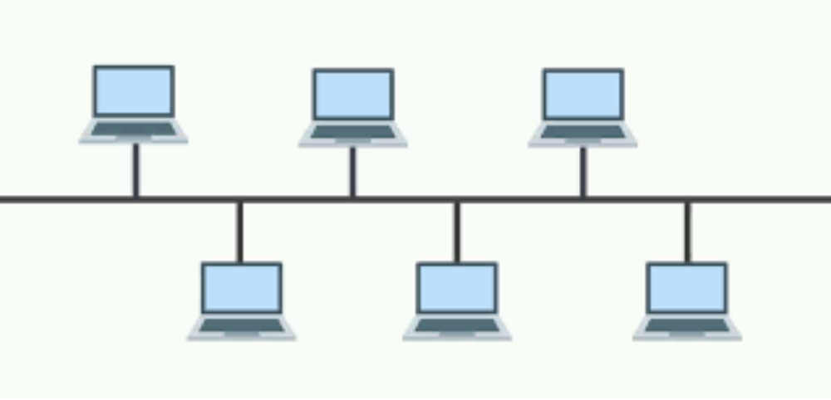
Computer Networks
Bus Networks
In this network, every computer is linked to a single connection line or cable through an interface. Thus each computer can directly communicate with other computer or device in the network. Bus networks are typically peer-to-peer.

Slide 5
Computer Networks
Bus Networks
The advantages of a bus network include:
Even if one node fails, the remainder of the network continues to function.
It is easy to increase the size of the network by adding additional nodes.
The disadvantages of a bus network are:
If the main cable fails, the whole network goes down.
The performance of the network deteriorates under heavy loading.
The network is not secure since each packet passes through every node.

Slide 6
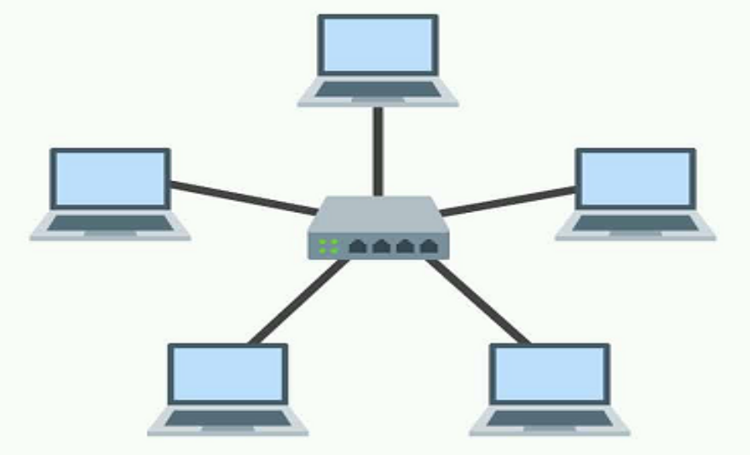
Computer Networks
Star Networks
In the Star network, the server is connected to each node individually. Server is also called the central node. Any exchange of data between two nodes must take place through the server. It is the most popular topology for information and voice networks as central node can process data received from source node before sending it to the destination node

Slide 7
Computer Networks
Star Networks
The advantages of a Star network include:
Failure of one node does not affect the network
Troubleshooting is easy as faulty node can be detected from central node immediately
Simple access protocols required as one of the communicating nodes is always the central node
Useful for evolving networks where devices are frequently added or removed.
The disadvantages of a Star network are:
Long cables may be required to connect each node to the server
The initial installation costs are high.
Failure of central node brings down the whole network

Slide 8
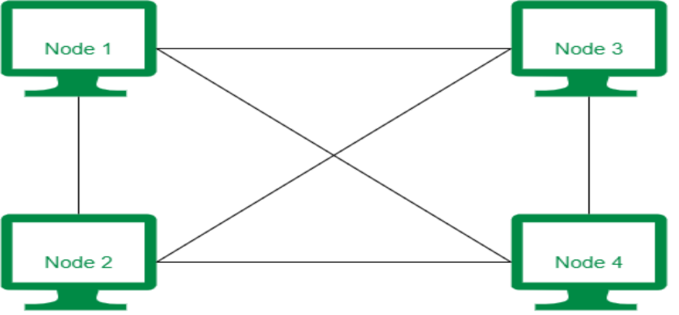
Computer Networks
Mesh Networks
It is a point-to-point connection to all devices. In this arrangement all the network nodes are connected with each other. Data is transmitted over the toplology via:
  Routing: giving the nodes routing logic so that data is directed to its destination by the shortest route or rerouted if one of the node has failed.
  Flooding: sends the data via all the nodes and uses no routing logic, which can lead to unnecessary loading on the network.

Slide 9
Computer Networks
Mesh Networks
The advantages of a Mesh network include:
It is easy to identify where faults on the network have occurred.
Any broken links in the network do not affect the other nodes.
Good privacy and security, since packets travel along dedicated routes.
The network is relatively easy to expand.
The disadvantages of a Mesh network are:
A large amount of cabling is needed, which is expensive and time consuming.
Set-up and maintenance is difficult and complex.

Slide 10
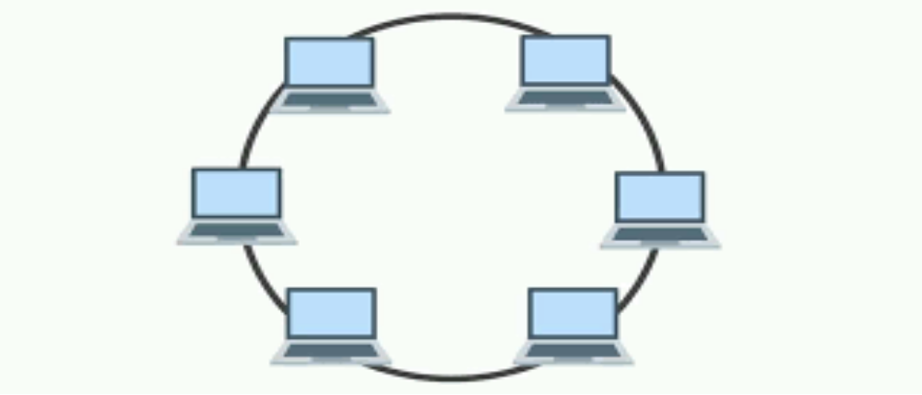
Computer Networks
Ring Network
A ring network topology consists of multiple computers or devices communicated in a closed-loop by a single communication medium. The information traverse around the ring to every station because it reaches the desired computer or device. The data flow can be unidirectional or bidirectional too. In a unidirectional ring, the data act in one direction only, while in bidirectional, it works in both directions.

Slide 11
Computer Networks
Ring Network
The advantages of a Ring network include:
It is a truly distributed data processing system.
It is more decent than the star network.
If one station fails in the network or a channel between two fails, an alternate routing is possible
The disadvantages of a Ring network are:
Communication delay is directly proportional to the multiple nodes in the network.
It has more complicated control software.

Slide 12
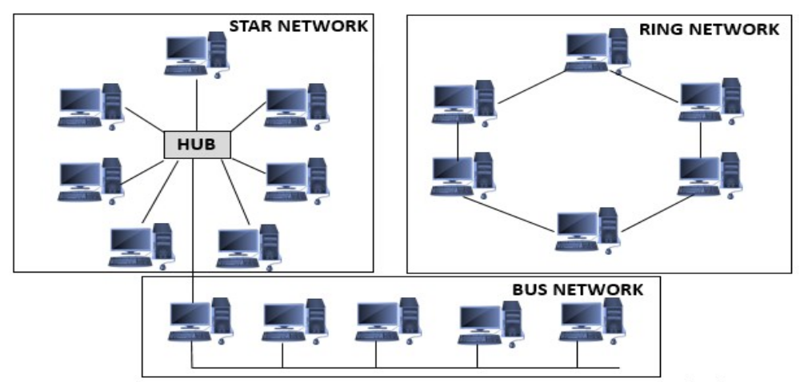
Computer Networks
Hybrid Network
Hybrid Network is the combination of two or more differentntopologies. For example, in a college there are many departments, if one department uses ring topology and another department uses Star topology, connecting these two topologies which results in Hybrid Topology.

Slide 13
Computer Networks
Hybrid Networks
The advantages of a Hybrid network include:
They can handle large volumes of traffic.
It is easy to identify where a network fault has occurred.
They are very well suited to the creation of larger networks (scalable).
The disadvantages of a Hybrid network are:
Designing the hybrid network is difficult or complex.
It is costly

Slide 14
Computer Networks
Cloud Computing
Cloud Computing: Delivery of computing services—including servers, storage, databases, networking, software, analytics, and intelligence—over the Internet (“the cloud”) to offer faster innovation, flexible resources, and economies of scale.
Cloud Storage: method of data storage where data is stored on offsite servers in many locations.

Slide 15
Computer Networks
3 Types of Cloud Storage Systems
Private Cloud: A cloud compting service where the infrastructure is completely controlled by a single organization and not shared with others (eg:HP Data Centres, Ubuntu).
Public Cloud: A cloud computing that's delivered via the internet and shared across organizations. It is operated on the pay-as-per-use model and administrated by the third party, i.e., Cloud service provider (eg: Microsoft Azure, IBM's Blue Cloud, Sun Cloud, and Google Cloud)
Hybrid Cloud: A combination of private and public clouds. Some data resides in the private cloud and less sensitive/less commercial data can be accessed from a public cloud storage provider (eg: Amazon, Microsoft, Google, Cisco).

Slide 16
Computer Networks
Pros and Cons of Cloud Storage
Advantages | Disadvantages
Easy acces to data anytime from any device any where in the world | Lack of control as data is held offisite by the cloud servce provider.
Lower risk of system failure as data is backed up on external device far away from one's location | Difficult to migrate the data from one cloud storage provider to another due to the massive amount of data.
Lower cost as it eliminates the need to pay for software licenses and server infrastructure | Requires stable internet to download or access the remotely stored data
Scalability as there is only the need to pay for the amount of storage that is needed | Security and privacy concerns as confidential data is handed over to a third-party cloud service provider (eg: security glitch in dropbox results in leaking of customer's confidential data)
Better security as cloud storage companies offers password protected and encryption technology to ensure the data remain secure. | Expensive to pay for high download/upload data transfer limits with the customer/client internet service provider (ISP)

Slide 17
Computer Networks
Cloud Software
Software applications can be delivered to user's computer:
Cloud provider host and manage the software (e: maintenance, upgrades and security)
User simply connect to the internet (using their web browser on a computer or tablet or mobile phone) and contact their cloud services supplier.
The cloud services supplier will connect them to the software application they require.
Advantage of Cloud Software
It does not need to be stored on user device.
User can still use the software even if internet conection is lost.
Data can be stored on local device and uploaded once connection is stored.

Slide 18


Computer Networks
Wireless Networks
Wireless Networking can be achieved through:
Wifi Bluetooth

Slide 19
Computer Networks
Wireless Networks
Bluetooth Communication
A short range of wireless technology for exchanging data between devices
Pick up one of the available radio frequency at random to connect to one of the available devices.
Selects available frequency through spread frequency hopping.
Changes frequency channels to avoid interference with devices.
Bluetooth is useful in the following situations
Supports data transfer of devices less than 30 metres apart
Data transmission speed is not critical
Using low bandwith applications
Wifi Communication
It also uses spread frequency hopping
More suited for full scale (larger) networks
It has better data transfer rates, range and data security than bluetooth

Slide 20
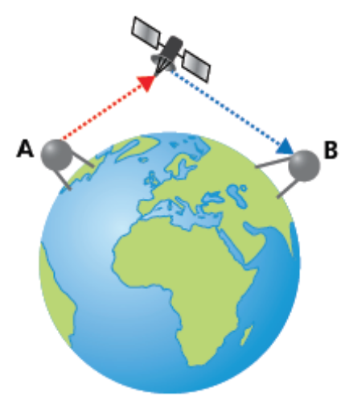
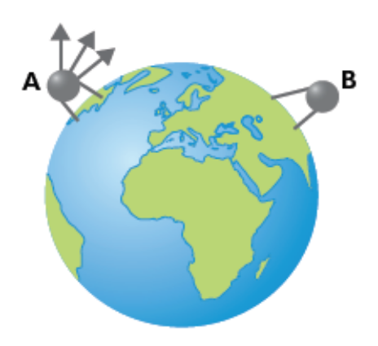
Computer Networks
Wireless Networks
Satellite Communication
Electromagnetic waves carry the signals, but the curvature of the Earth prevents such methods transmitting data globally
The electromagnetic radiation from antenna. A is transmitted but is unable to reach antenna B due to the Earth’s curvature.
The signal is beamed from antenna A to a satellite orbiting Earth, and boosted by the satellite orbiting Earth and beamed back to Earth and picked up by antenna B.

Slide 21
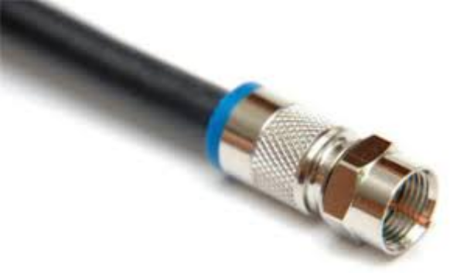
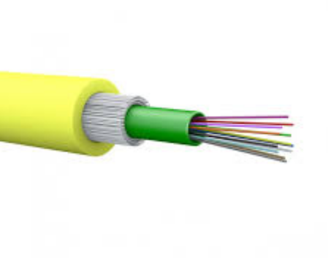
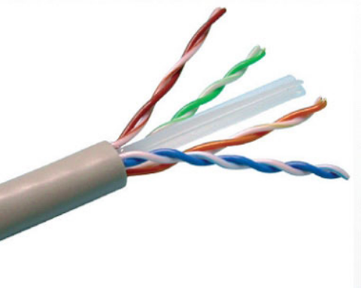
Computer Networks
Wired Networks
There are three main types of cable used in wired networks
Coaxial Cable
Fibre Optics
Twisted Pair

Slide 22
Computer Networks
Wired Networks
Twisted pair cables
Most common cable type used in LANs.
Has the lowest data transfer rate
Suffers the most from external interference (such as electromagnetic radiation).
It is the cheapest option.
Coaxial cables
Commonly used by cable television companies.
More costly than twisted pair.
Better data transfer rate than twisted pair.
Better transmission capacity (80 times) than twisted pair.
Fibre optic cables
Able to send data over long distances
Best data transfer rate
Smallest signal attenuation (signal lost)
High resistance to external interference.
Highest cost among the three (disadvantage).

Slide 23
Computer Networks
Factors to consider when choosing wired and wireless connectivity
Wireless Networking | Wired Networking
Easier to expand networks and is not necessary to connect devices using cables. | More reliable and stable network (wireless connectivity is often subjected to interference).
Devices have increased mobility, provided they are within range of the WAP | Data transfer rates tend to be faster with no ‘dead spots’.
Increased chance of interference from external sources | Tends to be cheaper overall, in spite of the need to buy and install cable.
Data is less secure than with wired systems; it is easier to intercept radio waves and microwaves and hence encryption is needed | Devices are not mobile; they must be close enough to allow for cable connections.
Data transmission rate is slower than wired networks (although it is improving) | Lots of wires can lead to tripping hazards, overheating of connections (potential fire risk) and disconnection of cables during routine office cleaning.

Slide 24
Computer Networks
Class Activity (Weekly Test)
1 Explain the differences between LAN, and WAN.
2) Give three of the benefits of networking computers.
3) Give one benefit and one drawback of using Bus, Star and Mesh Topology.

